Slide 1
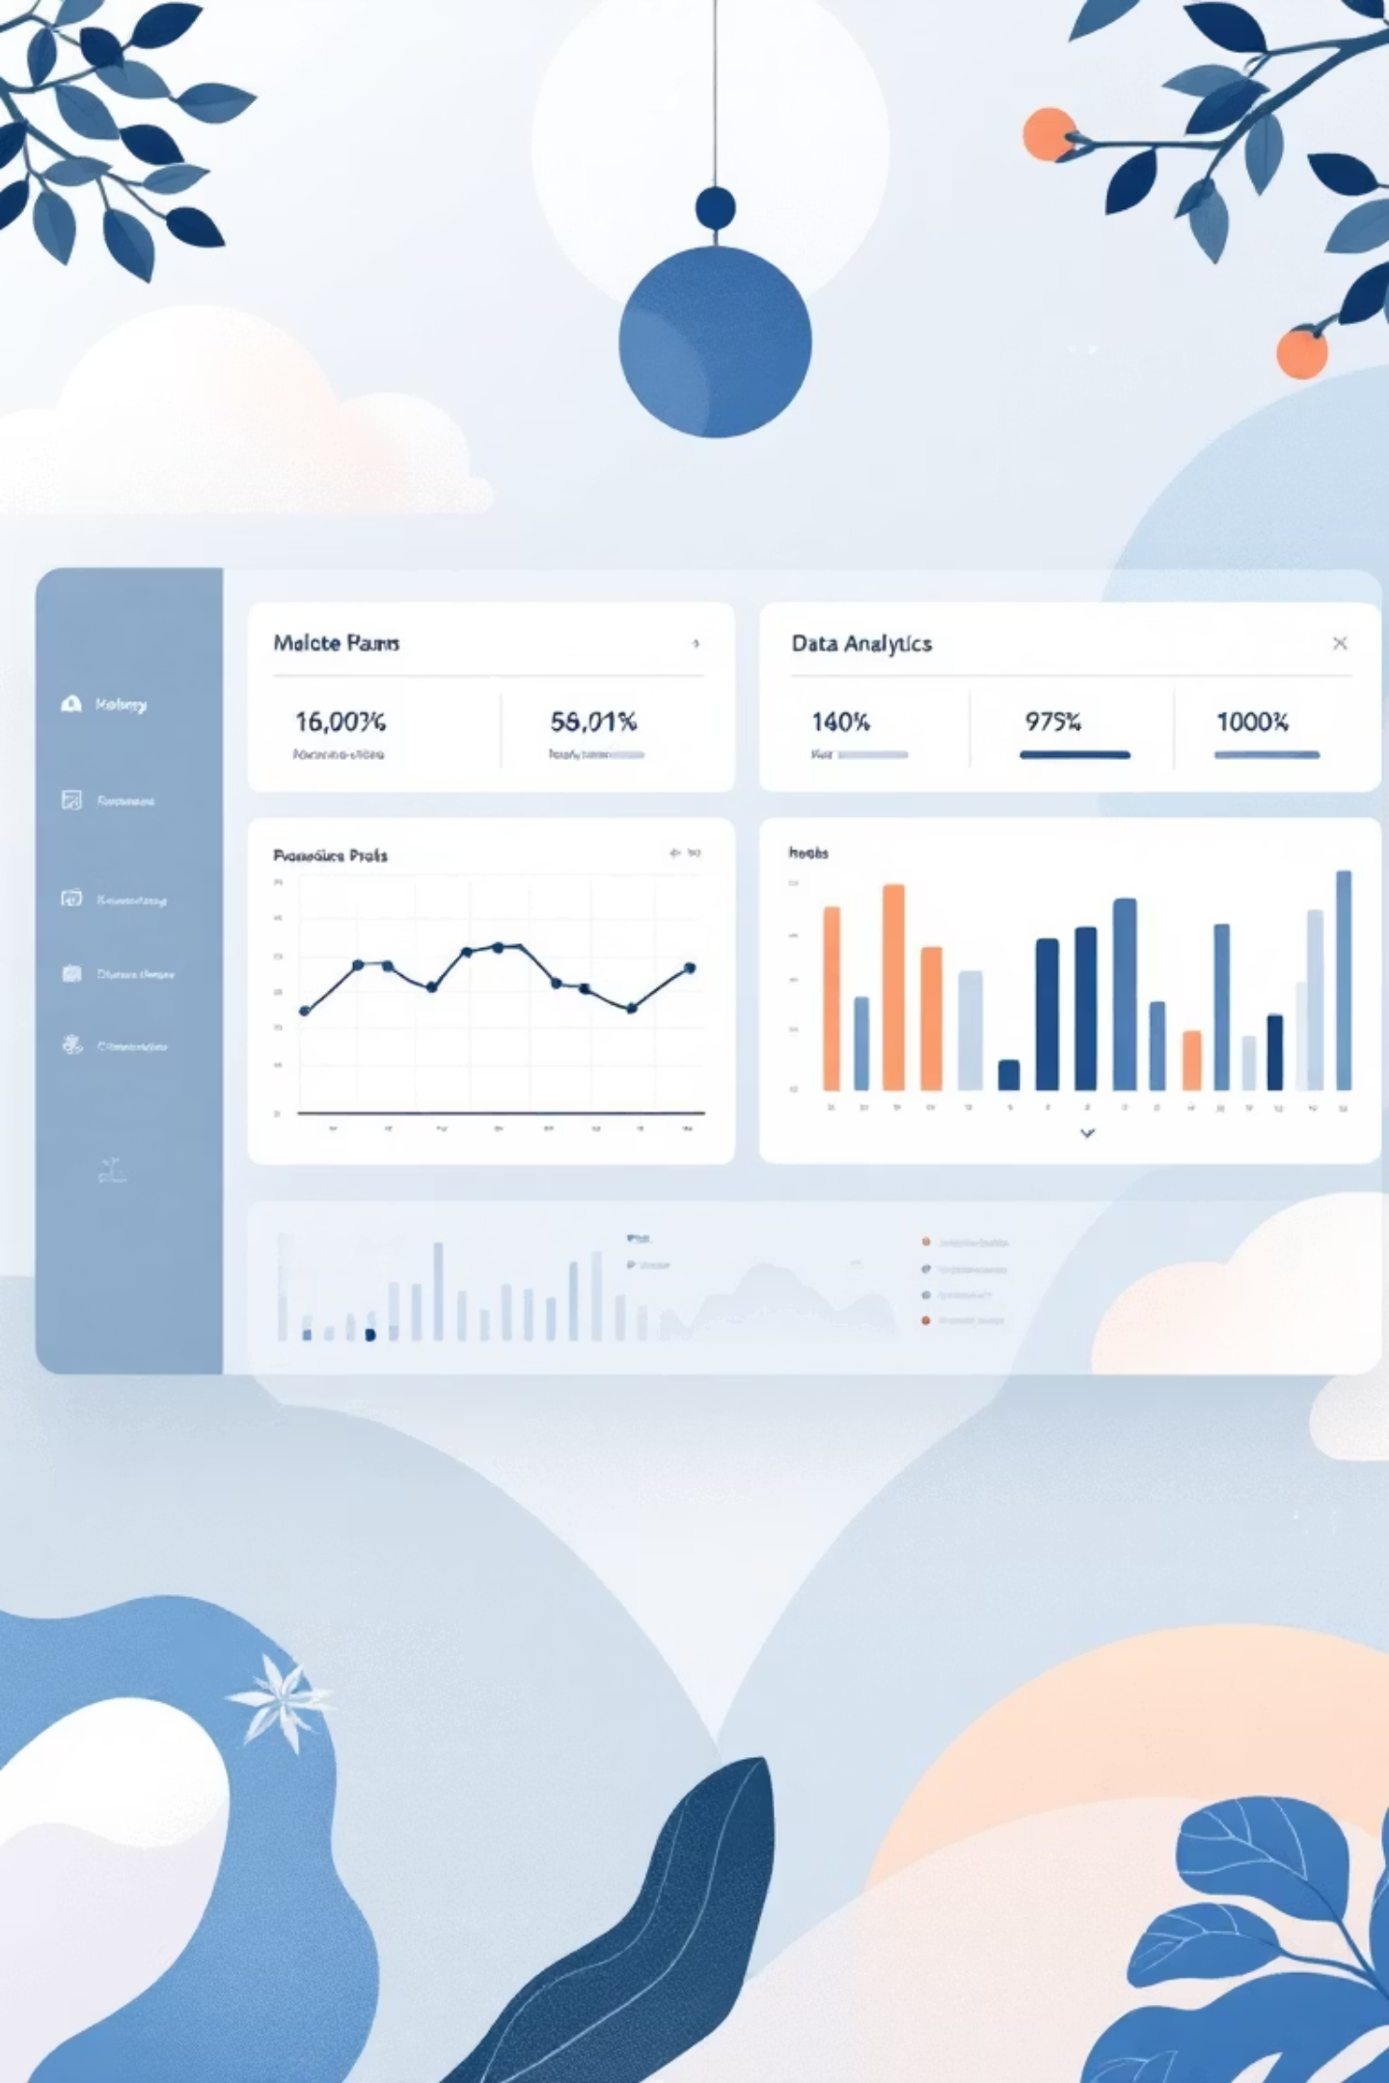
SuperStore Sales & Business Performance Analytics System
An end-to-end data analytics and engineering solution transforming raw sales data into actionable business intelligence
Technologies: Python • Pandas • Databricks • PySpark • Apache Airflow • Power BI

Slide 2
Business Context & Problem Statement
Current Challenges
Business Impact
Large SuperStore operating across multiple regions with fragmented data systems
Delayed decision-making hurting competitive advantage
Sales data trapped in raw CSV files scattered across departments
Inability to quickly identify underperforming products or regions
Manual reporting processes consuming hours of analyst time
Missed opportunities for optimization and cost savings
Error-prone spreadsheet calculations leading to unreliable insights
Management lacks confidence in data accuracy
No centralized system for analytics and reporting
Limited real-time visibility into profit margins, discount impacts, and loss patterns

Slide 3





Project Objectives
Automate Data Processing
Eliminate manual data handling and create scheduled, reliable ETL pipelines that process sales data automatically
Track Performance Metrics
Monitor sales trends, profit margins, and discount patterns across categories, regions, and time periods
Identify Opportunities
Discover high-performing products to scale and loss-making items to optimize or discontinue
Enable Data-Driven Decisions
Provide clear, interactive dashboards empowering business leaders with actionable insights

Slide 4





Overall Architecture & Data Flow
Built on the Medallion Architecture pattern, ensuring data quality improves at each stage while maintaining scalability and traceability
Raw CSV Files
SuperStore sales data in original format
Bronze Layer
Ingestion with validation and logging
Silver Layer
Cleaned and standardized data
Gold Layer
Analytics-ready aggregations
Power BI
Interactive dashboards
This architecture enables automated processing, data quality controls, and scalable analytics capable of handling growing data volumes

Slide 5
Step 1: Data Ingestion — Bronze Layer
The Bronze layer serves as our landing zone, preserving raw data while establishing the foundation for downstream processing.
01
02
03
Load CSV Files
Schema Validation
Quality Checks
Imported SuperStore sales data using Python and Pandas libraries
Verified column types, date formats, and numeric field integrity
Implemented data profiling to identify anomalies early
04
05
Error Handling
Raw Preservation
Added comprehensive logging and exception management
Stored unmodified data for auditability and reprocessing
Key Technologies
Benefits Achieved
Python & Pandas provided the flexibility to handle various CSV formats and perform initial validation efficiently.
Complete data lineage from source to destination
Early detection of data quality issues
Audit trail for compliance and troubleshooting
Foundation for reproducible analytics

Slide 6
Step 2: Data Cleaning & Transformation — Silver Layer
The Silver layer transforms raw data into a clean, standardized format ready for analytics, ensuring consistency and reliability.
Deduplication
Missing Value Treatment
Standardization
Removed duplicate records based on order ID and line item combinations, preventing inflated metrics
Handled nulls strategically: imputed where appropriate, flagged critical missing data, and documented decisions
Unified region names, category labels, and date formats across all records for consistent analysis
Derived Metrics
Optimized Storage
Created calculated fields including Profit Margin percentage, Discount Impact, and Performance Categories
Converted to Parquet format for efficient storage and faster query performance in downstream analytics

Slide 7
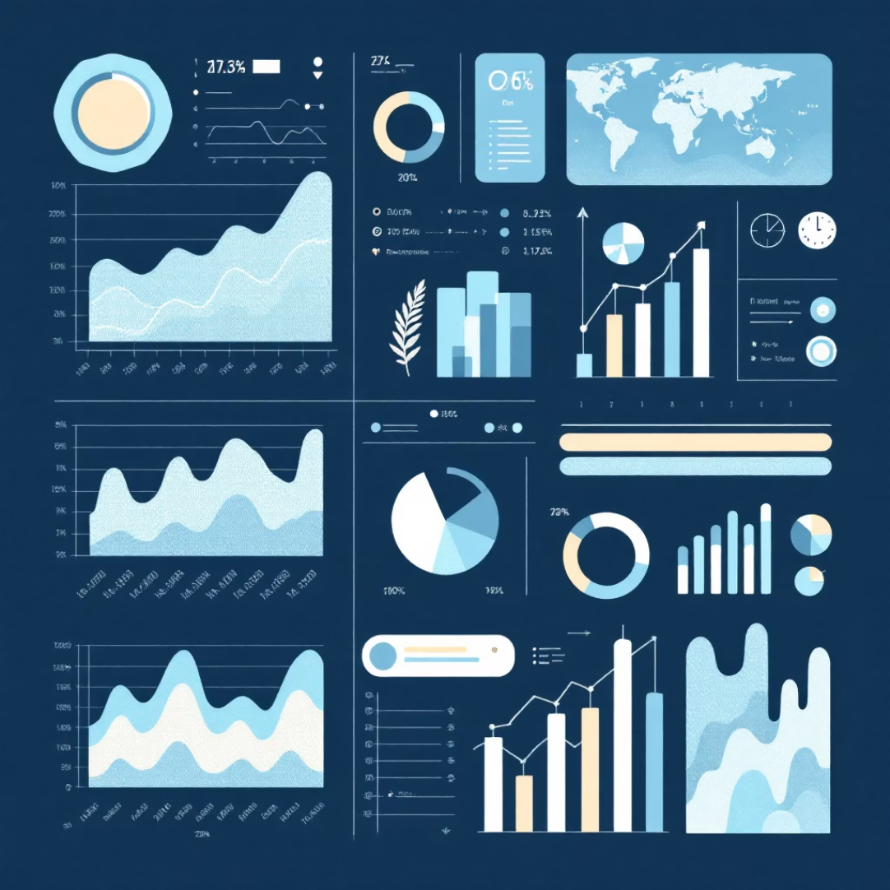
Step 3: Sales & Profitability Analytics — Gold Layer
Advanced Analytics with PySpark
Key Analytics Performed
Leveraged Databricks and PySpark for scalable, distributed computing on large datasets, enabling complex analytics that would be impractical with traditional tools.
Temporal Analysis
Sales and profit trends by month, quarter, and year identifying seasonal patterns
Category Performance
Deep-dive into category and sub-category profitability and volume metrics
Loss Identification
Flagged products with negative margins or excessive discounting
Regional Comparison
Analyzed sales distribution and profitability across geographic regions
Customer Segmentation
Grouped customers by purchase behavior and lifetime value
Results stored as aggregated tables optimized for visualization and business intelligence tools

Slide 8
Step 4: Workflow Automation — Apache Airflow
Implemented production-grade orchestration ensuring reliable, scheduled execution of the entire data pipeline
DAG Design
1
Created directed acyclic graphs defining task sequences and dependencies
2
Bronze Tasks
Scheduled CSV ingestion and validation jobs
Silver Tasks
3
Automated cleaning and transformation workflows
4
Gold Tasks
Triggered analytics aggregation processes
Monitoring
5
Real-time alerts and retry logic for failures
Reliability Features
Scheduling
Benefits
Automatic retry on failure
Daily incremental updates
Zero manual intervention
Task dependency management
Weekly full refreshes
Consistent data freshness
Execution history tracking
On-demand manual triggers
Reduced operational overhead

Slide 9
Step 5: Visualization & Reporting — Power BI
Connected Power BI directly to Gold layer outputs, creating interactive dashboards that transform data into actionable business intelligence
Sales Performance Dashboard
Profitability Analysis
Category Intelligence
Executive KPIs
Profit margin tracking by product, category, and region with drill-down capabilities for root cause analysis
Side-by-side category and sub-category performance with competitive benchmarking and growth indicators
High-level business metrics and health indicators designed for leadership decision-making and strategy sessions
Real-time revenue tracking, trend analysis, and year-over-year comparisons across all business dimensions

Slide 10

Testing, Validation & Project Outcomes
Quality Assurance Process
Project Success Metrics
1
Calculation Validation
95%
100%
Verified sales totals, profit calculations, and discount impacts using PySpark aggregations against source data
Time Saved
Automation
2
Cross-Platform Testing
Reduction in manual reporting effort
Fully automated daily pipeline execution
Compared analytics results between Gold layer outputs and Power BI dashboards ensuring consistency
24/7
3
Data Accuracy Audit
Availability
Conducted end-to-end reconciliation from Bronze to Gold, confirming no data loss or corruption
Real-time dashboard access for stakeholders
4
ETL Performance
Final Outcome
Validated pipeline reliability with multiple runs, testing error handling and recovery mechanisms
Delivered a production-ready, enterprise-grade analytics system enabling data-driven decision-making across the organization. The automated pipeline ensures consistent, reliable insights while freeing analysts to focus on strategic analysis rather than data preparation.

Slide 11



